Slide 1

Using neural network to predict diffuse fraction k_{d} (ratio of the diffuse-to-global solar radiation)
散乱比
散乱比
ニューラルネットワークを使用して kd（全天日射量の ）を予測する
Final report
I studied about machine learning.
～ I understood how neural networks work and how they can predict data.
I made an artificial neural network to predict diffuse fraction.
～I got good results.
Student ID : 19909983
Name : Oscar Alberto Santos Muñoz
Yamada lab
January 28th, 2020

Slide 2
Research theme GOAL and immediate goals
GOAL：
Predict diffuse fraction with a neural network trained with global irradiance, date and time data of Nagaoka city.
Immediate goals：
Understand how neural networks work.
Analyze data.
Define model and architecture.
Train and test the neural network.
Analyze results.

Slide 3
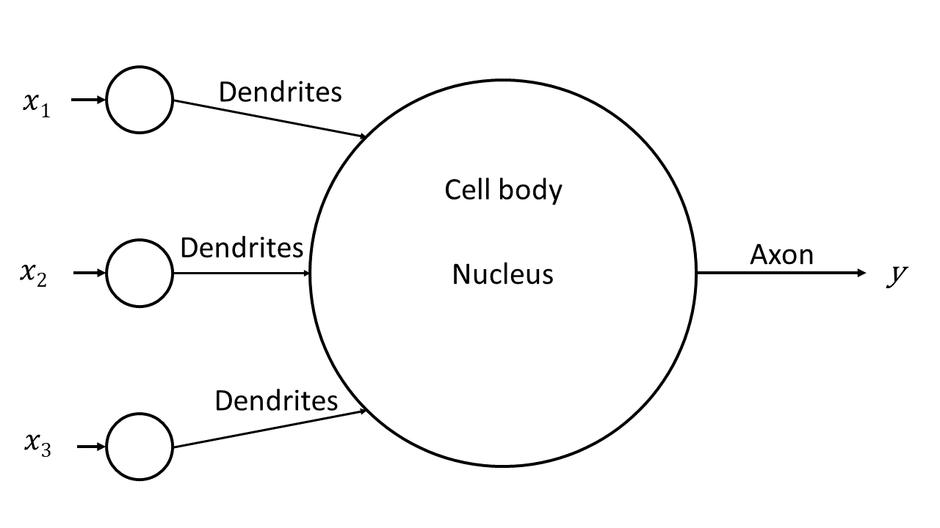
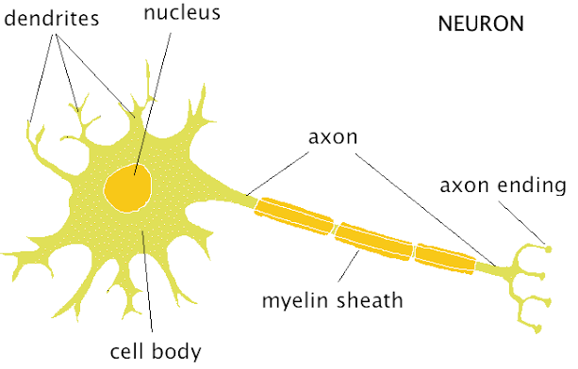
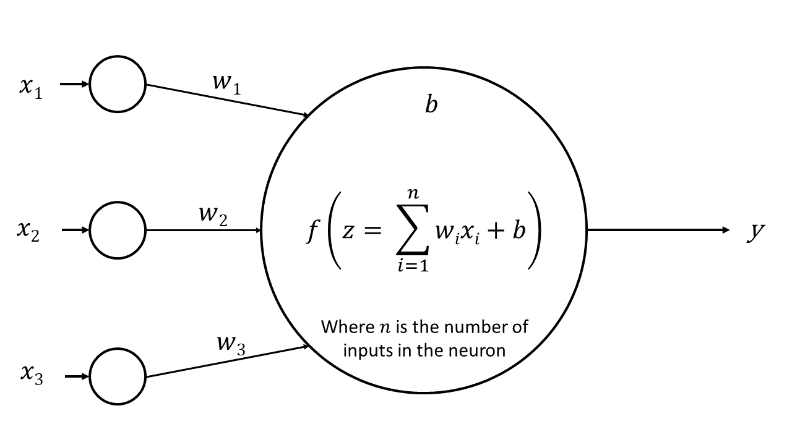
Background

Slide 4

Background
Input layer
Hidden layers
Global irradiance
#1
Output layer
#1
#1
Neuron # per layer
#1
#2
#2
Time
#2
#2
Array angle
#3
#64
#64

Slide 5
Background
Input layer
Hidden layers
Global irradiance
#1
Output layer
#1
#1
Neuron # per layer
Time
#2
#1
#2
#2
Diffuse fraction k_{d} = g
#3
#2
Array angle
#4
#64
#64

Slide 6
Background
Input layer
Hidden layers
Global irradiance
#1
#1
#1
Output layer
Neuron # per layer
Date
#2
k_{d} = g
Time
#3
#1
#2
#2
#2
Array angle
#4
#64
#64

Slide 7
Previous studies, tasks and issues pointed out
What I did・Points pointed out | Summary of results
The calculations of the diffuse fraction of each hour is required. | They were made in excel.
All data must be uploaded into python. | The data was storage in python lists.
Data analysis is required. | The first day and first year were plotted to better understand the general behavior.
The model must be built, compiled and trained. | An attempt with the first year of the data was made to train the network.
The documentation of the functions must be reviewed | The input problem was solved, however bad results were obtained.
Plot diffuse fraction (kd) vs GHI to see if kd depends only in GHI. | It was visualized that a linear regression is not an option to do the predictions

Slide 8
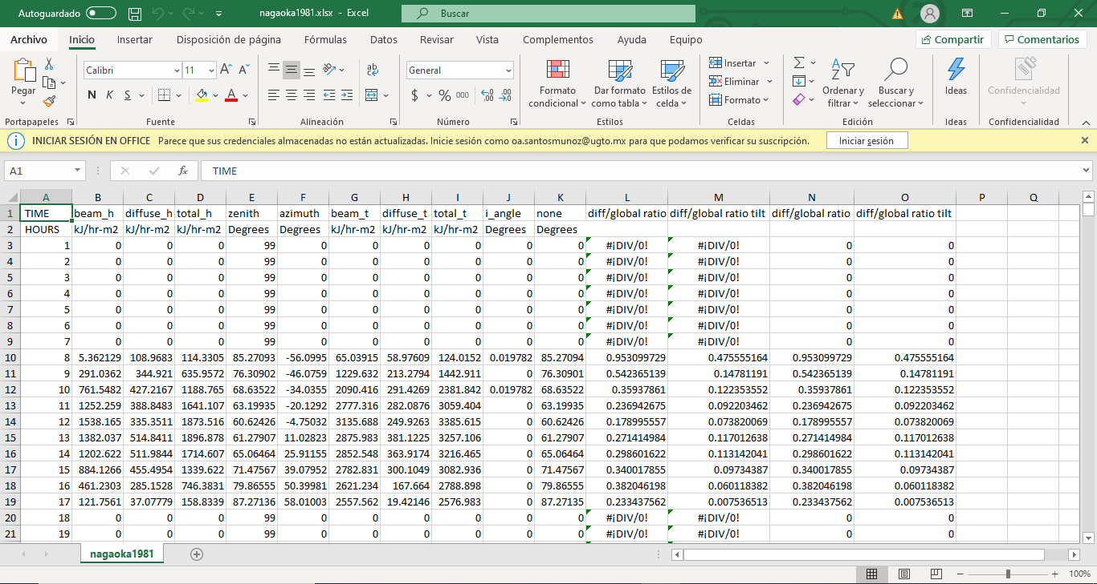
What I did
Nagaoka’s database

Slide 9
What I did
Nagaoka’s database

Slide 10
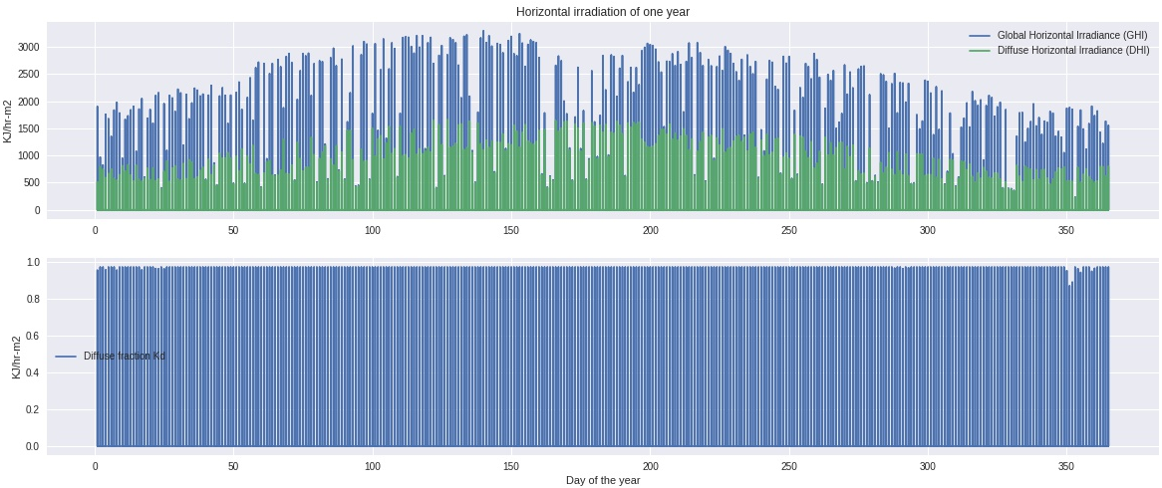
What I did

Slide 11
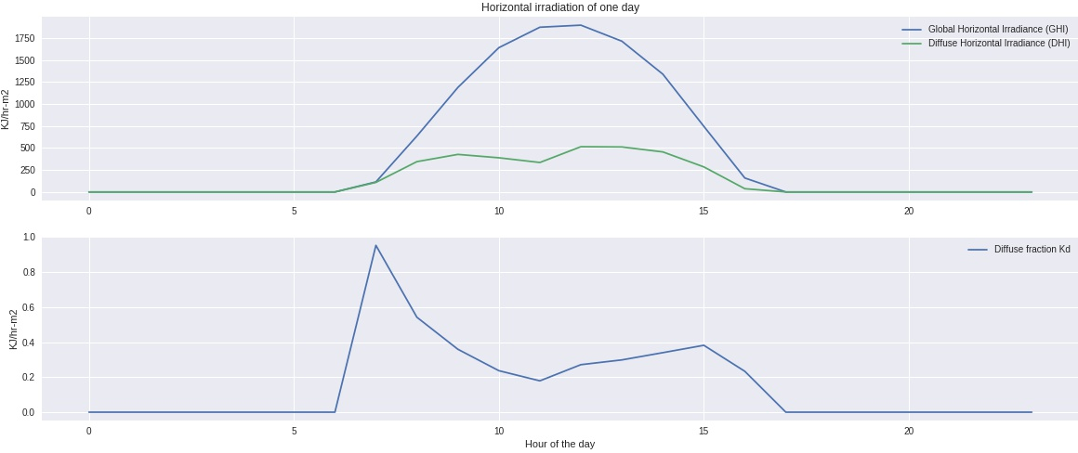
What I did

Slide 12
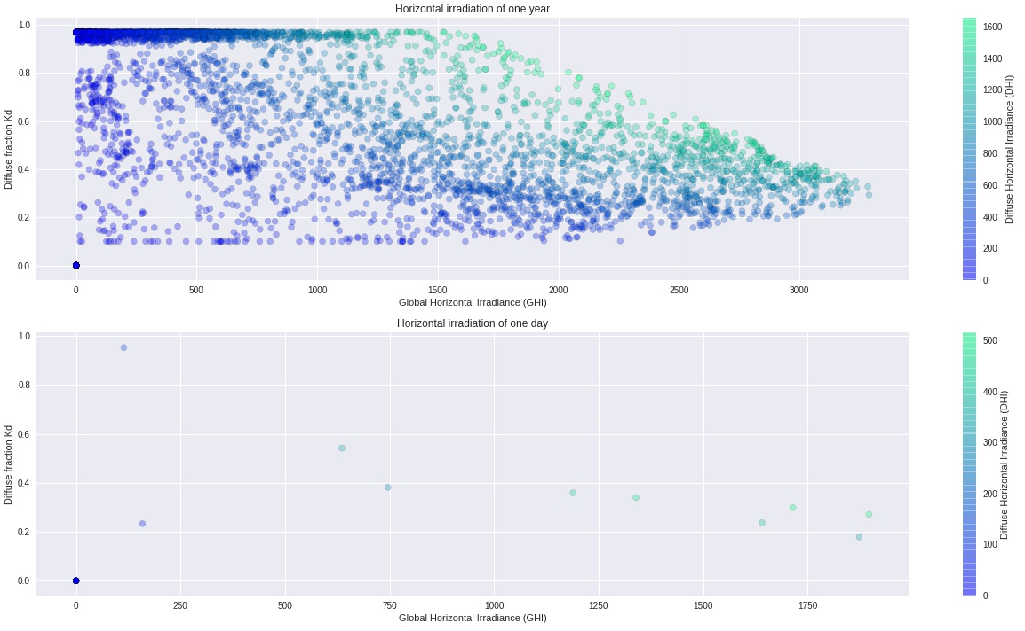
What I did

Slide 13
Contents and results after solving the issues and suggestions
What I did | Summary of results
Data had to be in required format. | Data were reshaped in 1 input matrix with dimensions (175200,3) and standardized.
Split into train, validation and test data. | The data were separated in 15 years of training, 2 years of validation during training and 3 years of testing.
Once the architecture of the network was chosen the model must be built, compiled and trained. | ANN with 46,565 trainable params and 0 non-trainable params
Analysis on the metrics | The loss and accuracy of the training were evaluated and 78.09% was achieved.
Make predictions and comparison | The predictions were made with the validation data and the test data.
Export the results | The results were exported to a csv file.

Slide 14
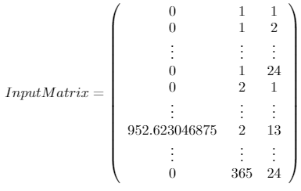
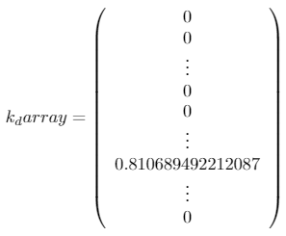
What I did : Data had to be in required format.
Gi Date Time
k_{d}
175200
175200
3
1

Slide 15
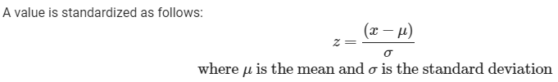
What I did : Data standardization

Slide 16
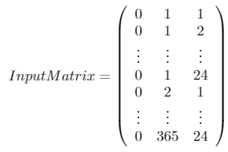
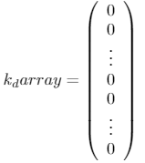
What I did : Split into train, validation and test data.
1 year = 24 hours x 365 days = 8760 hours
Training data | Validation data | Test data
15 years 8760 hours x 15 years = 131400 | 2 years 8760 hours x 2 years = 17520 | 3 years 8760 hours x 3 years = 26280
Gi Date Time
k_{d}
_{131400 / 17520 / 26280}
_{131400 / 17520 / 26280}
3
1

Slide 17
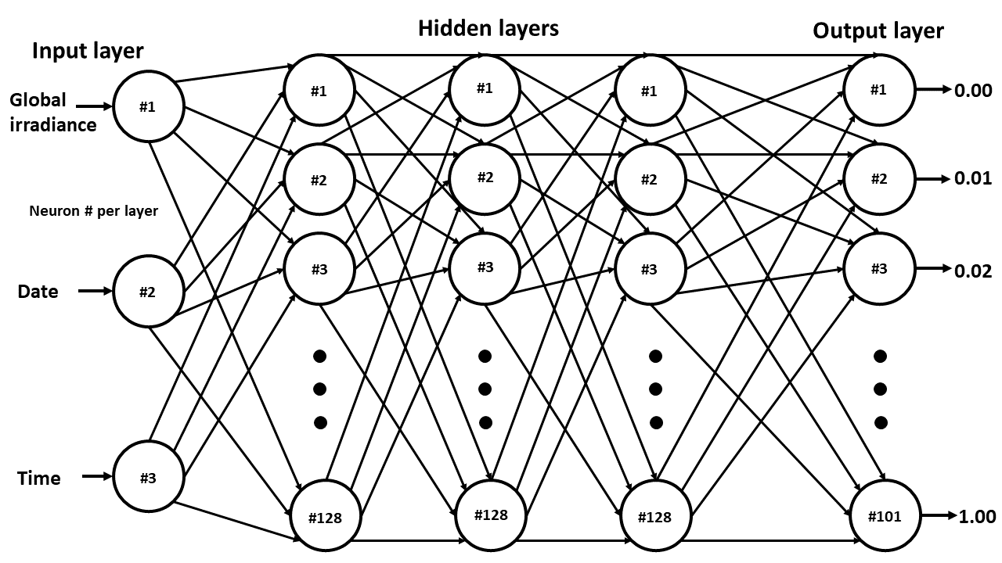
What I did : Architecture of the ANN
Activation functions: ReLU ReLU ReLU Softmax

Slide 18
What I did : Model and training params
Optimizer: Adam
Loss: sparse_categorical_crossentropy
Metrics: accuracy
Batch_size: 128
Epochs = 750

Slide 19
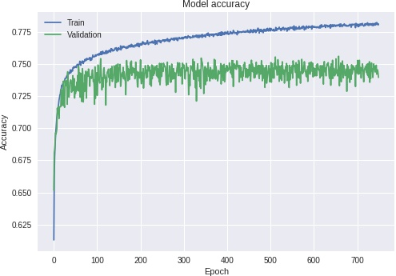
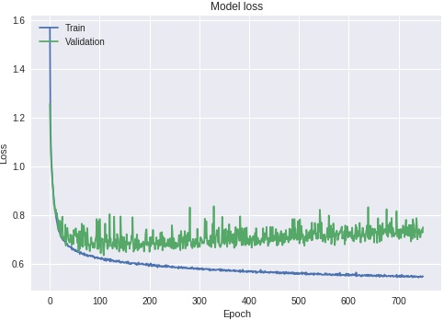
What I did : Analysis on the metrics

Slide 20
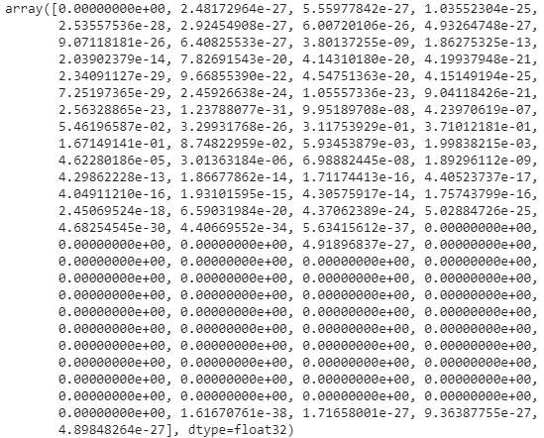
What I did : Make predictions and comparison

Slide 21
What I did : Make predictions and comparison
Hidden layers
Output layer
Input layer
Global irradiance
#1
#1
#1
#1
0.00
#1
#2
#2
#2
#2
0.01
Neuron # per layer
#3
#3
#3
#3
0.02
Date
#2
Time
#3
#128
#128
#128
#101
1.00
Activation functions: ReLU ReLU ReLU Softmax

Slide 22


What I did : Make predictions and comparison
Validation data | Test data

Slide 23
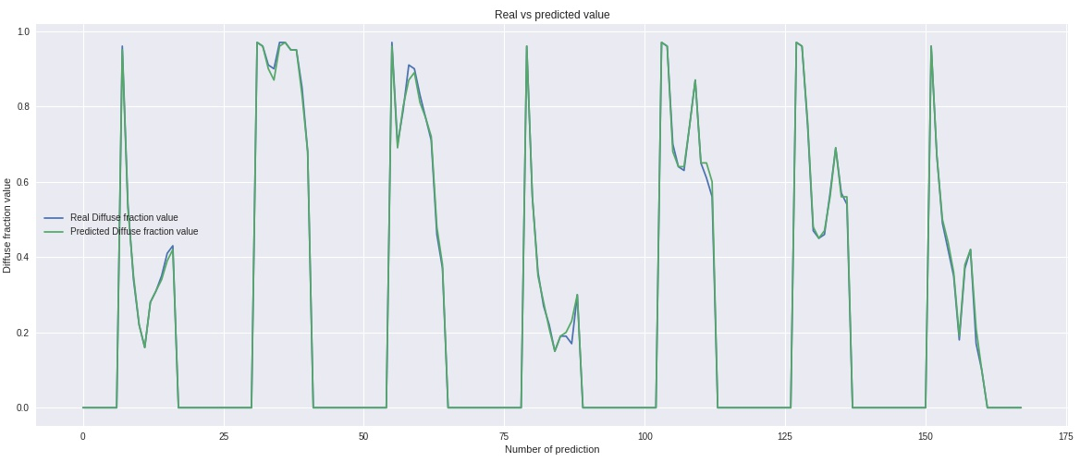
What I did : Make predictions and comparison

Slide 24


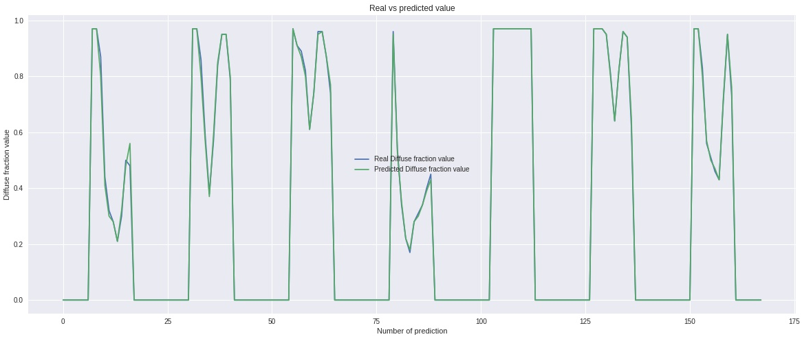
What I did : Make predictions and comparison
Mean Absolute error : 0.006887367 | Mean relative error : 1.525050225%

Slide 25
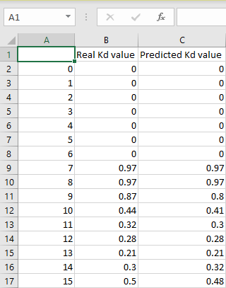
What I did : Export the results

Slide 26
Summary of the seminar this time and arrangement of issues
Conclusion
～I found it very interesting to see that given the accuracy of the network the values are very close to the real value of the diffuse fraction. There is no doubt that neural networks have a great future within the field of predictive analytics．
Future Tasks
～Improve accuracy by changing the architecture or try to increase it with more epochs in the training．
Wishes
～To publish an article．
Acknowledgements
～Special thanks to:
Prof.．YAMADA for giving me the opportunity to be in Energy Lab,
Mr. Kiyoshi for explaining me so many things related to neural networks,
Mr. Otaki for helping me with everything he could,
Mr. Uchida, Komiyama, Watanabe and all lab members for making me feel at home.

Slide 27
Thank you for your attention

